Slide 1
SkillSwap Project Proposal

Slide 2
Description
Our project is a skill-based social matching platform called SkillSwap.
Its goal is to help users find learning partners who are willing to exchange skills through one-on-one sessions — “you teach me what you know, I teach you what I know.”
Users can input the skills they have and the skills they want to learn. Based on this information, the app recommends potential partners with complementary skill sets. SkillSwap also provides features such as chatting, viewing user profiles, and adding friends to facilitate smooth communication and collaboration.
Project Contributors: Joseph Wajsberg
Xingzuo Li

Slide 3
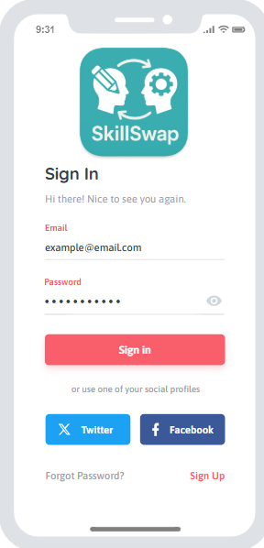
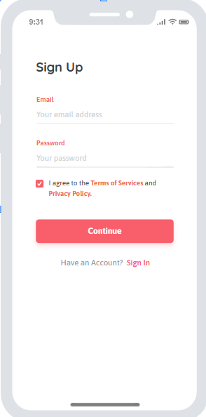
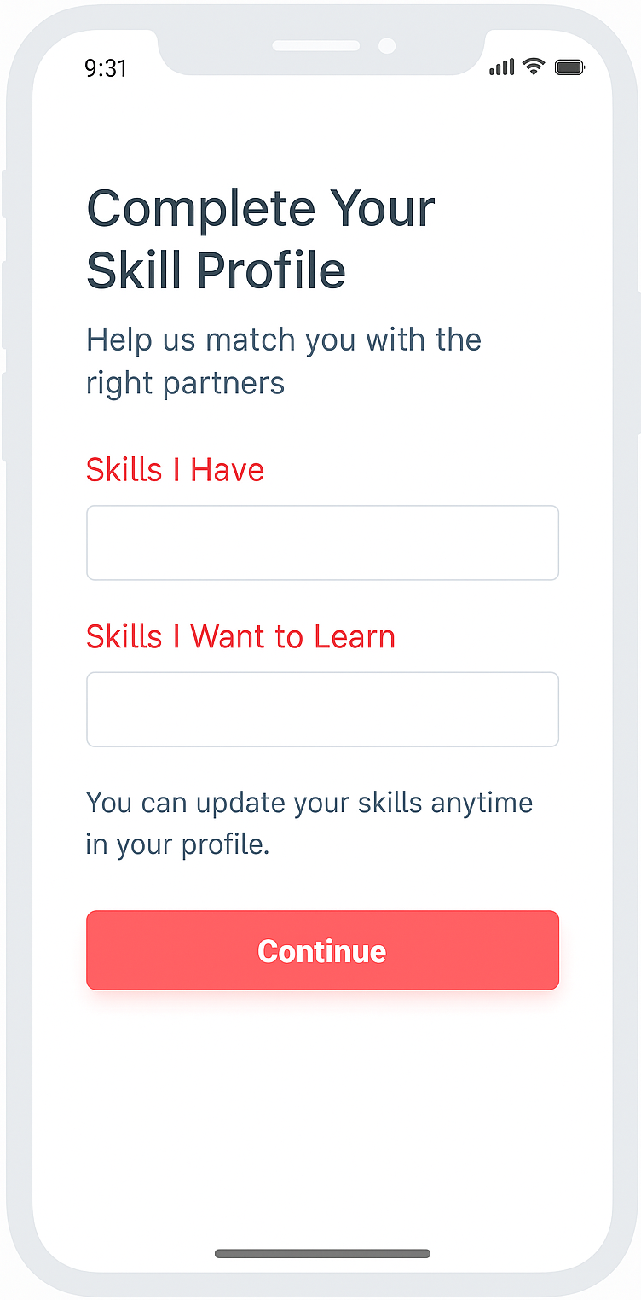
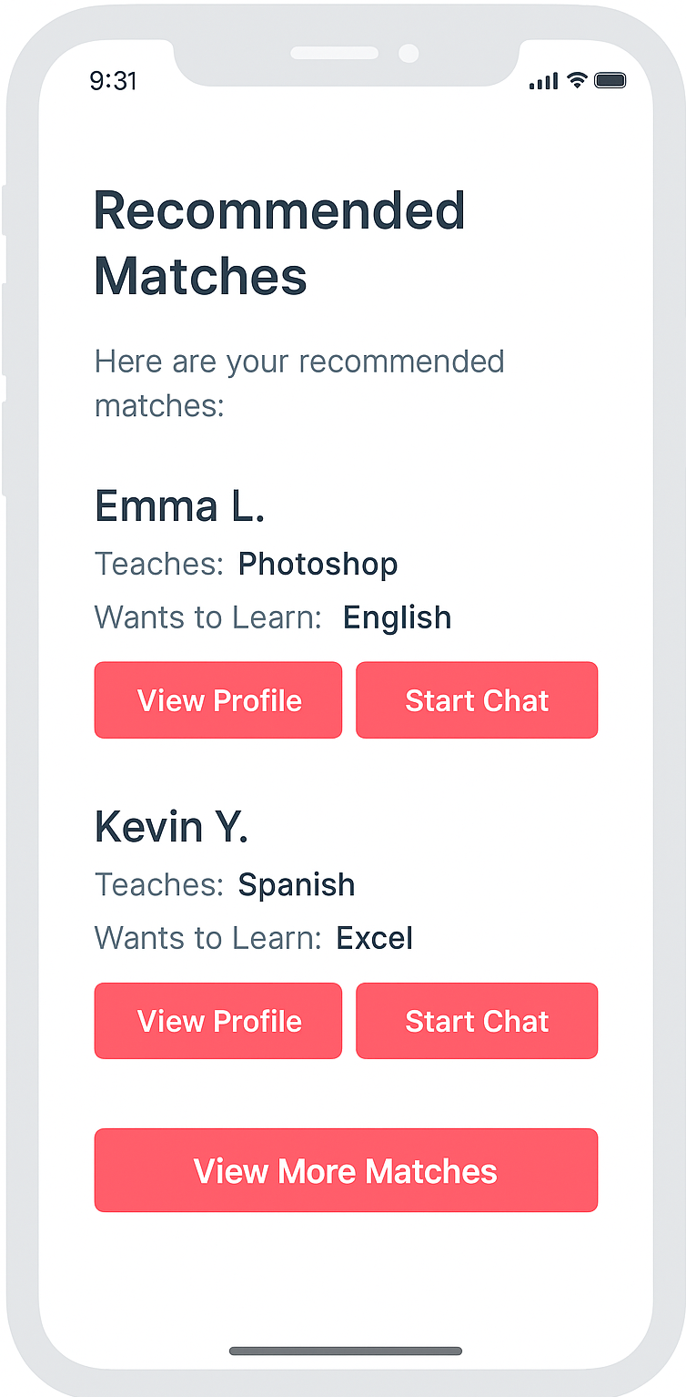
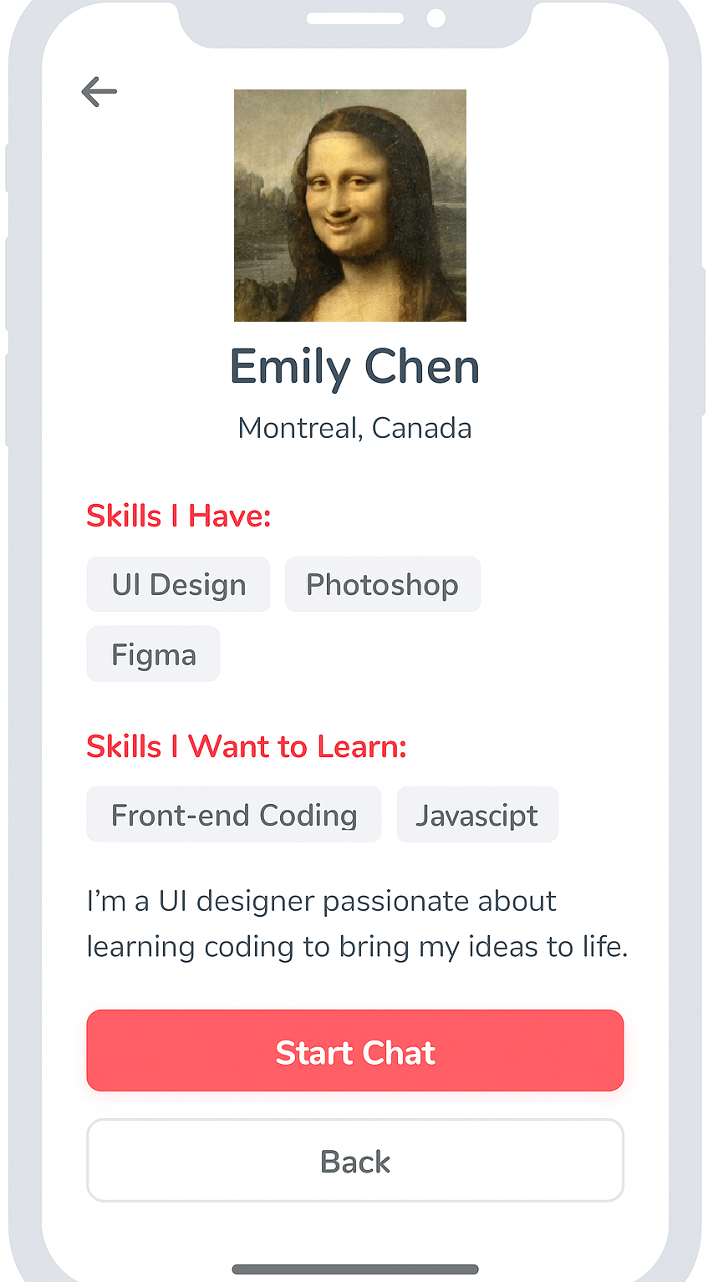
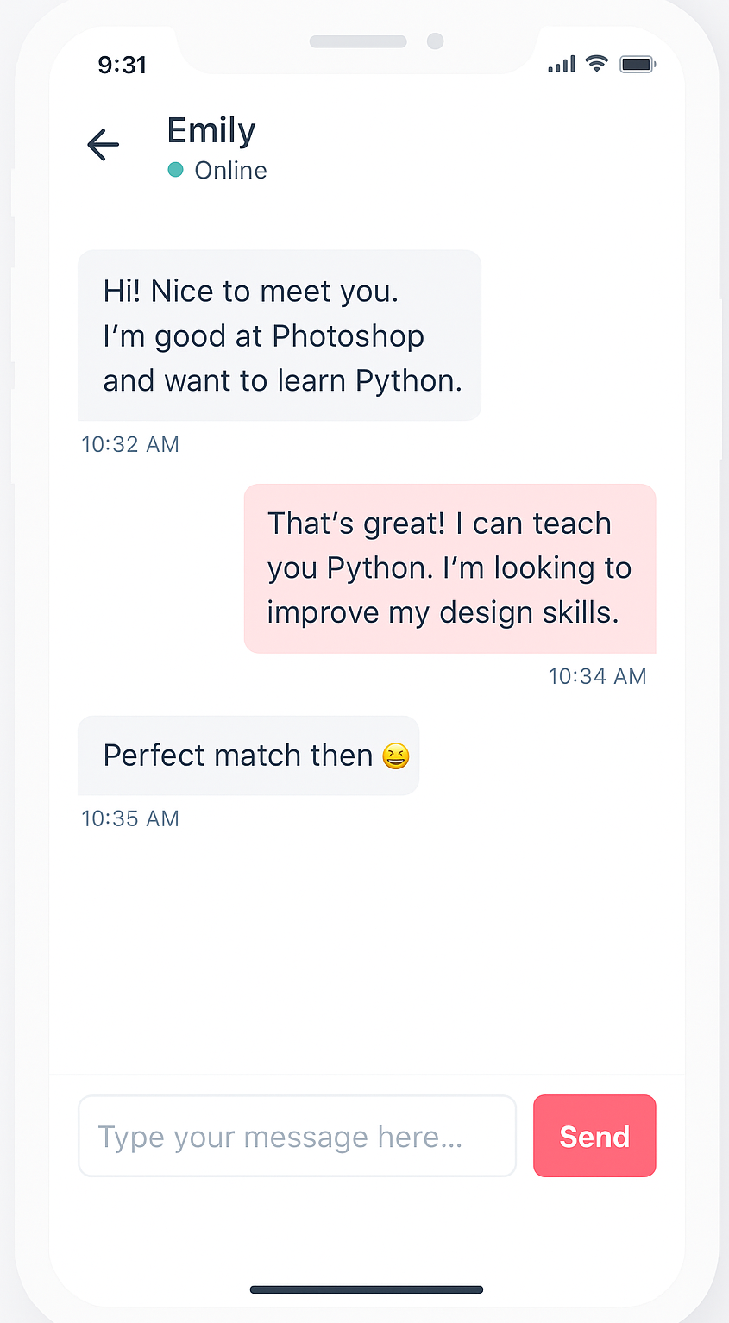
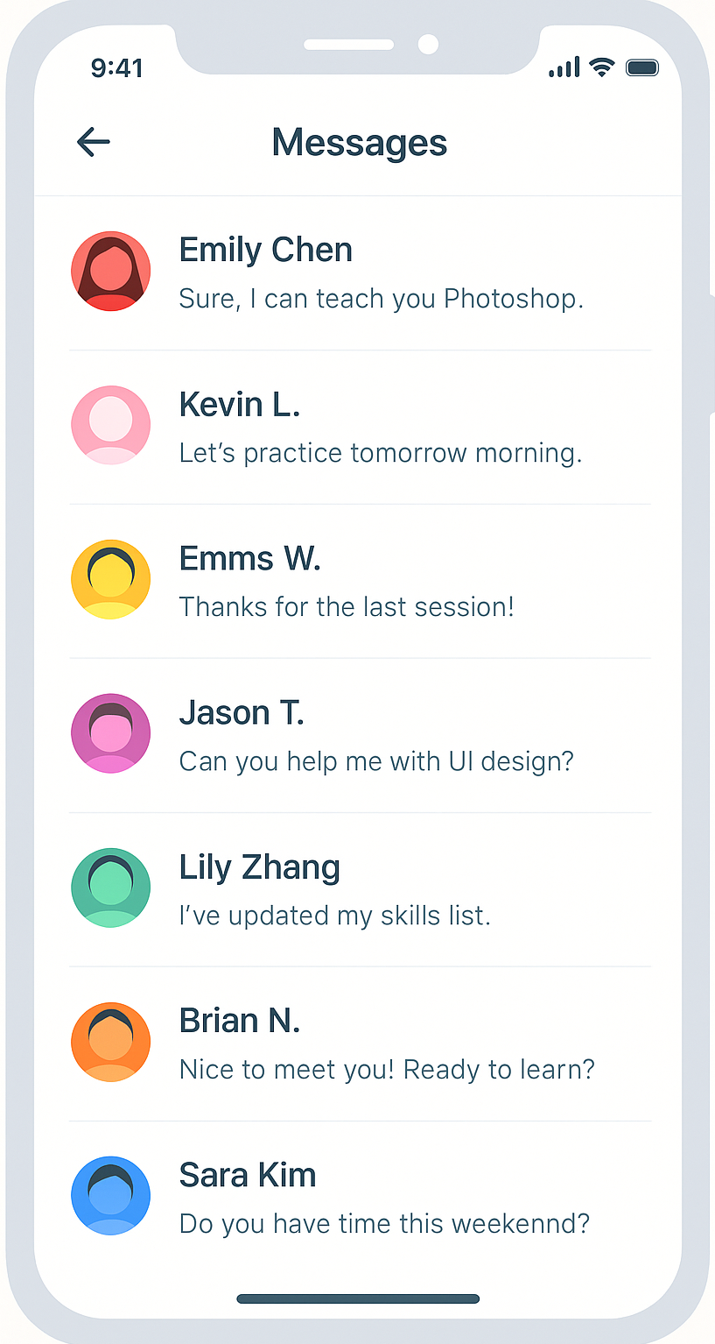
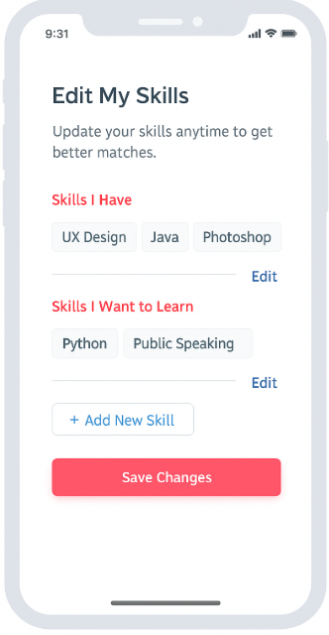
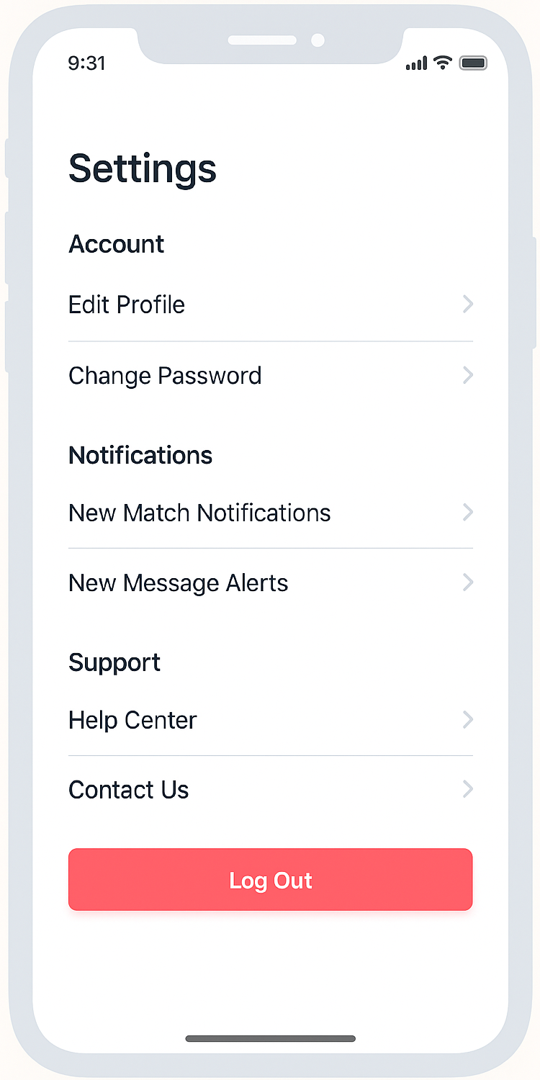
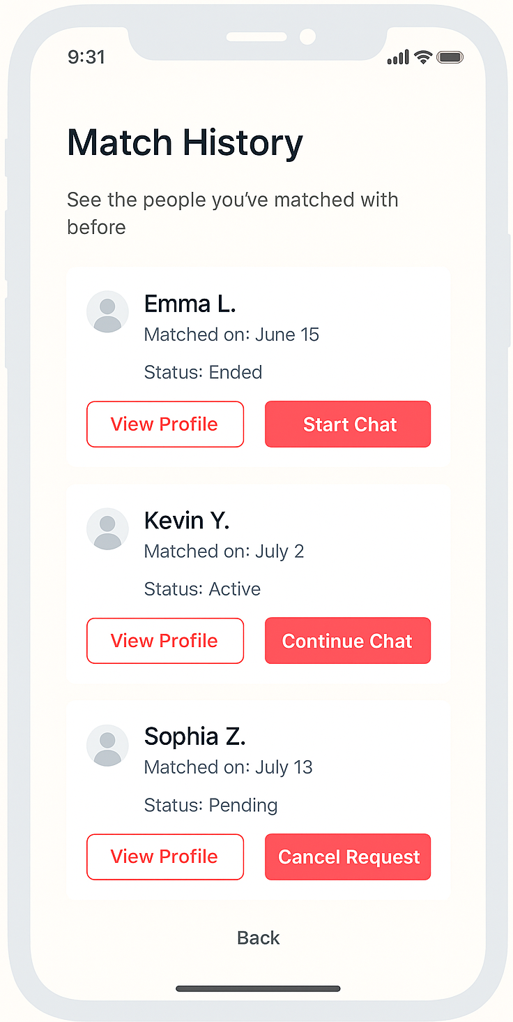
Mock - Up

Slide 4
Sign In Screen
This is the login screen of our app. It allows returning users to securely sign in with their email and password.
You may also sign in using Twitter or Facebook for convenience. Forgot password and registration options are available at the bottom.

Slide 5
Sign Up Screen
This is the sign-up screen of our app. New users can create an account by entering their email and a password.
They must agree to the Terms of Services and Privacy Policy before continuing. A link is provided to return to the sign-in page if they already have an account.

Slide 6
Complete Skill Profile Screen
This screen allows users to complete their skill profile. Users can enter the skills they currently have and the skills they want to learn.
This helps the system recommend the best learning partners. Users are reminded that they can update their skill profile at any time.

Slide 7
Recommended Matches Screen
This screen displays recommended skill exchange partners. Based on the user’s submitted skills and learning goals, the system suggests matching users.
Each match includes:
Name (e.g., Emma L.)
Skills they can teach
Skills they want to learn
Action buttons: 🔹 View Profile 🔹 Start Chat
At the bottom, there's a View More Matches button to explore additional connections.

Slide 8
User Profile Screen
This screen displays a selected user's public profile.
Displays the selected user’s profile, including:
Name, location, and profile picture
Skills they have and want to learn
Short self-introduction
Buttons: Start Chat and Back

Slide 9
Chat Screen
This screen allows users to chat with their matched partners. Users can exchange messages in real-time to discuss skills they want to learn or teach. Each message includes a timestamp for clarity. A message input box and Send button allow ongoing communication.

Slide 10
Messages Screen
This screen displays a list of recent conversations. Each entry shows the partner’s name, profile icon, and a preview of the latest message. Users can tap any item to open the full chat. The back icon allows users to return to the previous screen.

Slide 11
Edit My Skills Screen
This screen allows users to manage their skill profile. Users can update both the skills they have and the ones they want to learn. They can tap “Edit” to modify existing entries or use “+ Add New Skill” to add more. Saving changes helps improve match accuracy.

Slide 12
Match History Screen
This screen allows users to view past and current matches. Each match entry shows the user's name, match date, and current status. Users can view profiles, start or continue chats, or cancel pending requests.

Slide 13
Settings Screen
This screen allows users to manage their account and app preferences. Users can edit their profile, change their password, manage notifications, or contact support. The red “Log Out” button allows users to securely sign out of their account.

Slide 14
Other Information
Number of Screen Flows: 10 Screens
Programming Language: Dart
Backend Database: Firebase
Version Control: Git + GitHub
Team Members: Xingzuo Li, Joseph Wajsberg
GitHub Link: <https://github.com/adinashby-vanier-college/app-dev-2-project-skillswap.git>

